Slide 1
Profiling and Optimization of Reinforcement Learning Algorithms: Hardware and Software Insights
Presented By
Etcharla Revanth Rao - 24CS06010
Mora Girish Kumar - 24CS06001
Vytla Rakesh Mohan -24AI06004
Vasantha Sashank Reddy -24AI06003

Slide 2
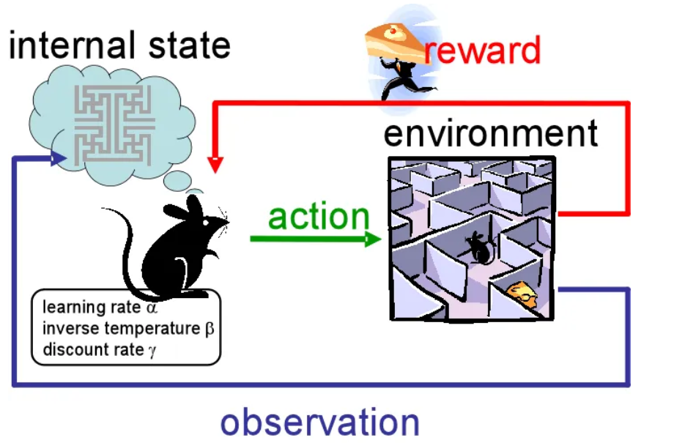
Why Reinforcement Learning (RL)?
RL is critical for solving complex tasks (e.g., robotics, gaming, autonomous systems).
High computational demands often require GPUs, but many systems (e.g., edge devices) are CPU-only.
Why Optimization?
CPU-based RL training is slow and resource-intensive.
Identifying hardware and software bottlenecks can improve efficiency on resource-constrained platforms.
Goal: Analyze and optimize RL algorithms for CPU-only systems

Slide 3
Problem Statement
Challenge:
RL algorithms (A2C, DDPG, PPO, SAC, TD3) exhibit varying performance on CPU-only systems.
Hardware bottlenecks (e.g., memory, CPU utilization) and software inefficiencies (e.g., convergence, losses) limit training efficiency.
Objective:
Profile five RL algorithms using Intel VTune Profiler and software metrics.
Identify hardware and software bottlenecks.
Propose optimizations to enhance performance on CPU-only Intel Coffee Lake systems.

Slide 4
Main Contributions
Comprehensive Profiling:
Analyzed five RL algorithms (A2C, DDPG, PPO, SAC, TD3) on CPU-only systems.
Used Intel VTune Profiler for hardware metrics and software training metrics for convergence and efficiency.
Bottleneck Identification:
Hardware: Low CPU utilization, high wait times, memory inefficiencies (LLC misses, latency).
Software: High losses, low explained variance, slow convergence.
Optimization Recommendations:
Hardware: Parallel environments, contiguous memory, vectorized computations.
Software: Adjusted learning rates, batch sizes, and entropy coefficients.
Visual Insights:
Reward curves and bottleneck heatmaps to highlight performance differences.

Slide 5
Evaluation Criteria
Software Metrics:
Reward: Measures convergence (higher is better).
FPS (Frames Per Second): Indicates computational efficiency.
Losses (Policy/Value/Actor/Critic): Reflects training stability.
Explained Variance: Measures value function accuracy (higher is better).
Hardware Metrics (VTune):
CPU Utilization: Percentage of core usage (higher is better).
Wait Time: Time spent idle (lower is better).
Memory Bound: Percentage of time stalled due to memory (lower is better).
LLC Misses: Cache misses (lower is better).
CPI: Cycles per instruction (lower is better).
Front-End/Back-End Bound: Pipeline stalls (lower is better).
Bad Speculation: Mispredicted branches (lower is better).

Slide 6
Experimental Setup
System:
Intel Coffee Lake CPU-only system.
8 cores, no GPU.
Algorithms:
A2C (LunarLander-v2), DDPG (Pendulum-v1), PPO (CartPole-v1), SAC (Pendulum-v1), TD3 (Pendulum-v1).
Training:
Steps: 2,048–10,240 (PPO), 800–9,600 (others).
Environments: OpenAI Gym (LunarLander-v2, Pendulum-v1, CartPole-v1).
Tools:
Intel VTune Profiler for hardware profiling (threading, hotspots, memory, microarchitecture).
Software metrics: Reward, FPS, losses, explained variance.
Profiling Duration:
Threading/Hotspot: 6–7 seconds.
Memory/Microarchitecture: 2.86–2.95 seconds.

Slide 7
Results - Software Performance
Algorithm | Environment | Reward (Start → End) | FPS (Start → End) | Losses | Explained Variance | Key Insights
A2C | LunarLander-v2 | 32.60 → 86.25(Target: ~200+) | 483 → 438 | Policy: 1.911 → 0.081Value: 9.294 → 0.060 | -0.0096 → 0.2251 | Slow convergence; high losses and low variance show inefficient learning. Moderate FPS due to sequential rollouts.
DDPG | Pendulum-v1 | -1500.80 → -519.78(Target: ~-100 to -200) | 43 → 35 | Actor: 26.76 → 76.66 → 58.66Critic: 0.013 → 1.889 | N/A | Strong improvement; high losses indicate instability. Low FPS from replay buffer and continuous actions.
PPO | CartPole-v1 | 23.19 → 60.98(Target: ~195+) | 1150 → 705 | Value: 56.23 → 71.19Policy: -0.0188 → -0.0151 | -0.0004 → 0.2762 | Slow convergence; high value loss and low variance reflect optimization issues. High FPS with rollout overhead.
SAC | Pendulum-v1 | -1558.54 → -529.26(Target: ~-100 to -200) | 38 → 33 | Actor: 26.70 → 90.64 → 75.50Critic: 0.223 → 2.727 | N/A | Strongest convergence; high losses and low FPS from complex Q-network updates.
TD3 | Pendulum-v1 | -1409.73 → -638.46(Target: ~-100 to -200) | 42 → 33 | Actor: 14.63 → 60.09 → 49.43Critic: 0.038 → 1.033 | N/A | Slower convergence; high losses and low FPS due to dual critics and delayed updates.

Slide 8
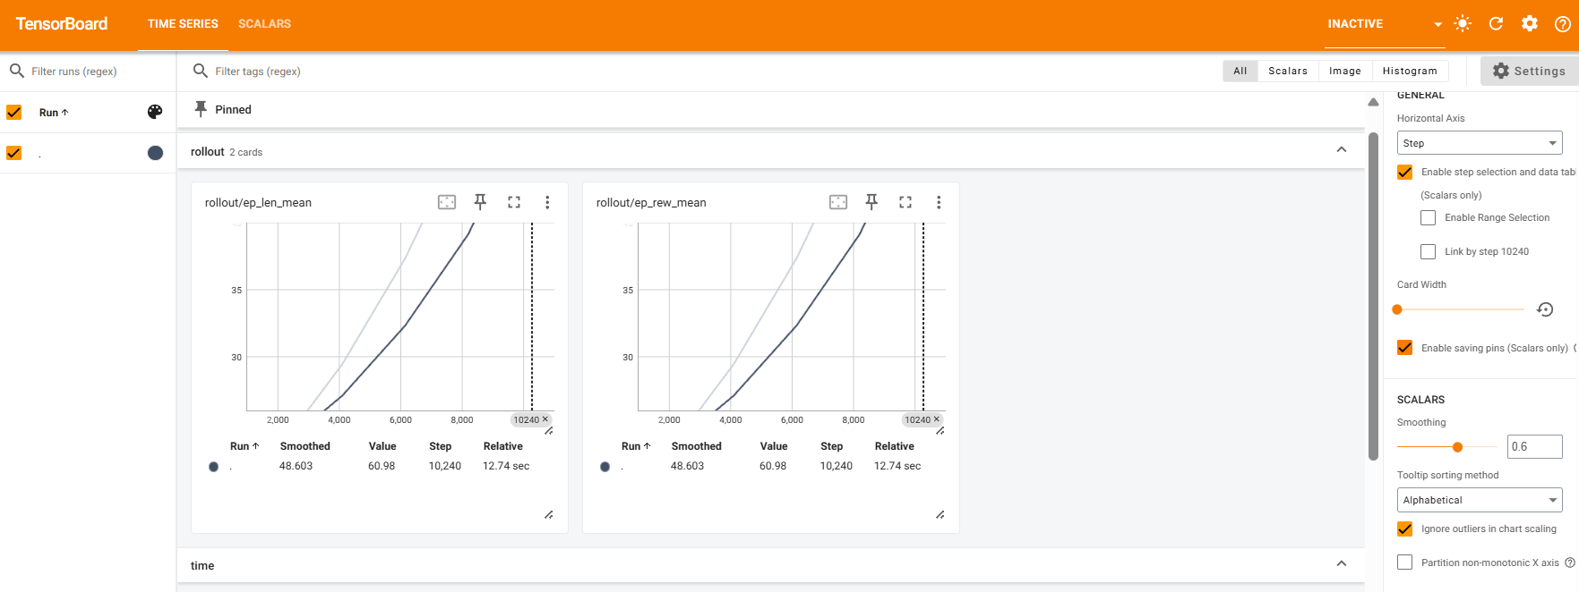
Software-Tensorboard
TensorBoard is a visualization tool for monitoring and analyzing machine learning model performance, displaying metrics like loss, accuracy, and resource usage as graphs and scalars.

Slide 9
Results - Hardware Performance
Key Metrics (Table II):
CPU Utilization: Low (10.3–11.0%, 0.822–0.879/8 cores).
Wait Time: High (38.12–55.39s, TD3 highest).
Memory Bound: 9.6–11.0% (TD3 highest).
LLC Misses: 6.3M–7.7M (SAC highest).
CPI: Good (0.82–0.83).
Front-End Bound: 34.8–39.4% (TD3 highest).
Bad Speculation: 10.3–11.5% (SAC highest).
Back-End Bound: 19.0–24.2% (A2C highest)
Hotspots:
Startup/I/O (LoadLibraryExw: 20.7–39.1%) dominates.
OpenMP overhead in PPO/SAC/TD3 (7.0–7.6%).
Insight:
Low CPU utilization and high wait times indicate synchronization issues.
Memory inefficiencies (LLC misses, latency) impact performance.

Slide 10
Discussion - Software-Hardware Correlation
Startup/I/O:
High initial losses (SAC: 90.64, PPO: 71.19) and low FPS correlate with LoadLibraryExw (20.7–39.1%) and wait time (38.12–55.39s).
Synchronization:
Low CPU utilization (10.3–11.0%) and OpenMP overhead align with sequential rollouts (A2C/PPO) and buffer sampling (DDPG/SAC/TD3).
Memory:
High actor/critic losses (SAC: 90.64) correlate with LLC misses (6.3M–7.7M) and latency (10.53–12.21 cycles).
Control Flow:
High losses and entropy adjustments (SAC) align with Front-End Bound (34.8–39.4%) and Bad Speculation (10.3–11.5%).
Value Function:
Low explained variance (A2C: 0.2251, PPO: 0.2762) correlates with Back-End Bound (A2C: 24.2%).

Slide 11
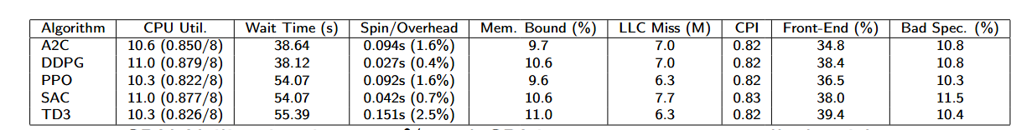
Key Matrix
- Wait Time: Higher values (e.g., 54.07–55.39s for PPO, SAC, TD3) indicate longer delays for resources, suggesting resource contention or complex computations.
- Spin/Overhead Time: Larger values (e.g., 0.151s for TD3) reflect inefficient resource use, like busy-waiting, impacting performance.
- Front-End Bound: Higher percentages (e.g., 39.4% for TD3) show bottlenecks in CPU instruction delivery, potentially causing execution stalls.

Slide 12
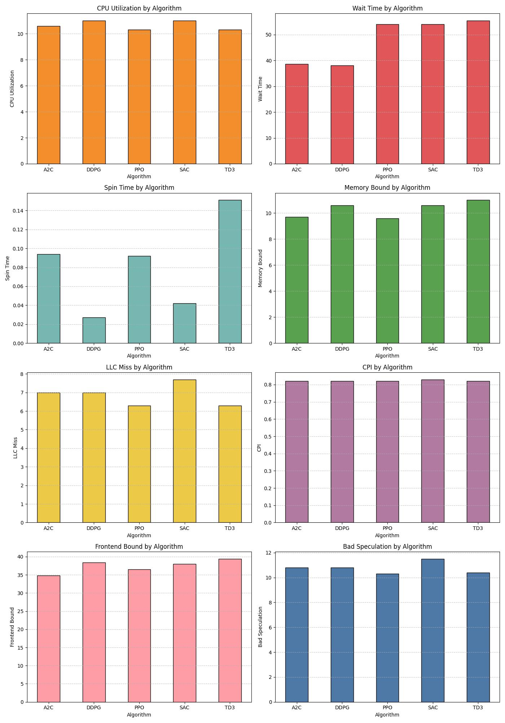
Key Matrix-Bar Graph
The Key matrix represented in the bar graph can be seen.

Slide 13
Discussion - Algorithm-Specific Insights
A2C: Slow convergence (86.25), high Back-End Bound (24.2%).
DDPG: Strong convergence (-519.78), but high startup overhead (LoadLibraryExw: 39.1%).
PPO: High FPS (705–1150), but slow convergence (60.98) and high memory latency (12.21 cycles).
SAC: Best convergence (-529.26), but high LLC misses (7.7M) and Bad Speculation (11.5%).
TD3: Slower convergence (-638.46), high wait time (55.39s) due to dual critic overhead.
.

Slide 14
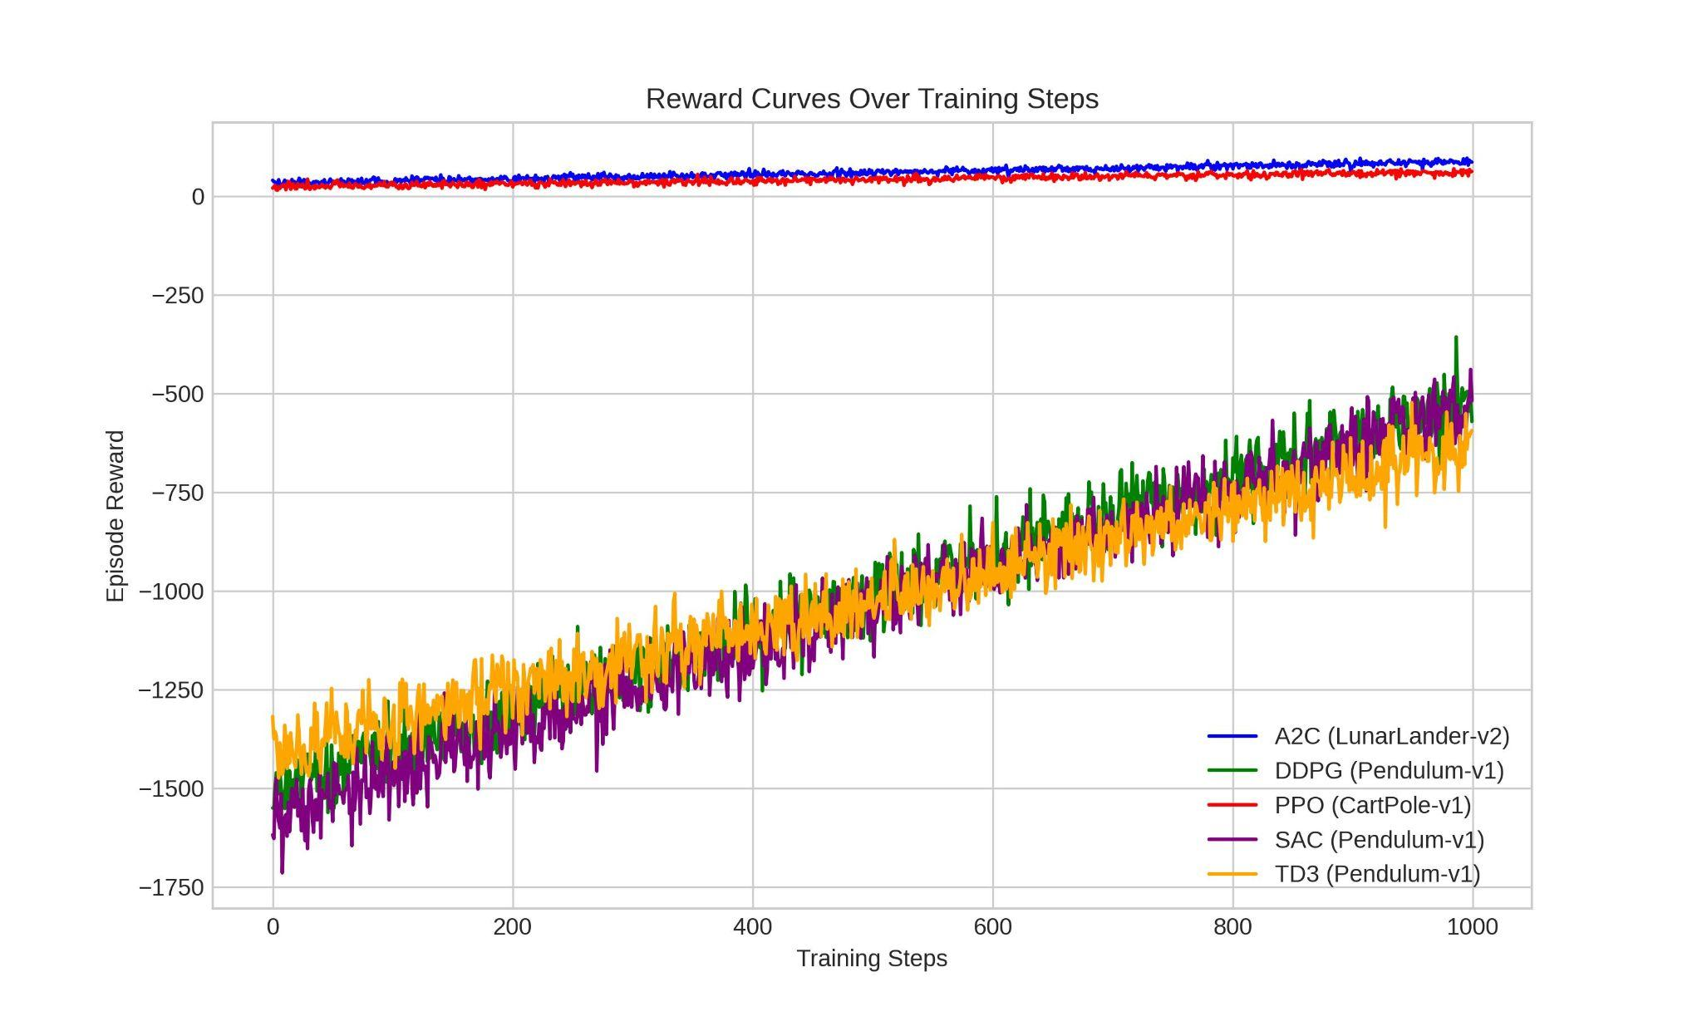
Visualizations - Reward Curves
Reward Curves illustrate the learning performance of RL algorithms, with SAC showing the best convergence, followed by DDPG, while A2C, PPO, and TD3 lag in their respective environments.

Slide 15
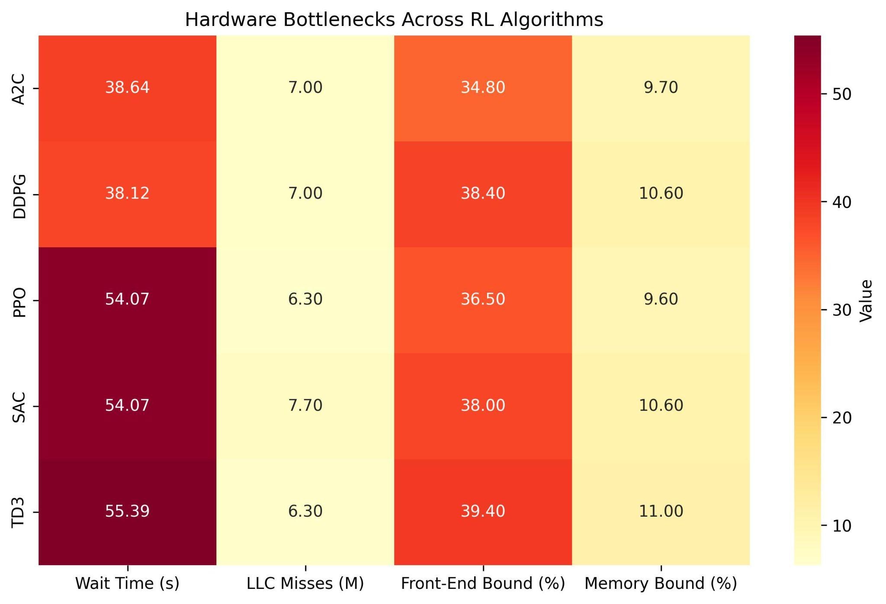
Visualizations - Bottleneck Heatmap
Bottleneck Heatmap highlights hardware inefficiencies, with TD3 suffering from synchronization delays, SAC facing memory issues, and all algorithms showing underutilized CPU and threading inefficiencies.

Slide 16
Optimization Recommendations
Hardware:
Threading: Use VecEnv (8 environments) to reduce wait time (TD3: 55.39s). Optimize OpenMP for PPO/SAC/TD3.
Hotspot: Profile longer (5–10 min) to capture RL-specific functions. Reduce TensorBoard logging.
Memory: Use contiguous NumPy arrays to lower LLC misses (SAC: 7.7M). Align data to 64-byte cache lines.
Microarchitecture: Vectorize control flow (Front-End Bound: TD3 39.4%). Use SIMD for PyTorch operations (Back-End Bound: A2C 24.2%).
Software:
A2C/PPO: Increase value function updates, use GAE (lambda=0.95) to improve explained variance.
DDPG/SAC/TD3: Reduce learning rate (0.0001), increase batch size (256) to stabilize losses.
SAC: Fine-tune entropy coefficient (0.134) for exploration/exploitation balance.

Slide 17
Conclusion
Key Findings:
SAC achieves the strongest convergence (-529.26), PPO offers the highest FPS (705–1150).
Major bottlenecks: Startup overhead, synchronization delays, memory inefficiencies.
Impact:
Optimizations (parallel environments, vectorized computations) can enhance RL efficiency on CPU-only systems.
Insights are critical for resource-constrained platforms (e.g., edge devices).
Limitations:
Short profiling durations (2.86–2.95s) limit RL-specific insights.
Focused on simple environments (e.g., CartPole, Pendulum).

Slide 18
Future Work
Complex Environments:
Profile RL algorithms on MuJoCo or other high-dimensional tasks.
GPU Systems:
Compare CPU vs. GPU performance to identify scalability bottlenecks.
Advanced Optimizations:
Implement and test proposed optimizations (e.g., VecEnv, SIMD).
Explore distributed RL training for CPU-only systems.
Longer Profiling:
Extend profiling duration to capture RL-specific functions and reduce startup dominance.

Slide 19
Q&A

